Slide 1

Simplifying JavaScript

Slide 2
Introduction
jQuery is a fast, small, & feature-rich JavaScript library. It makes things like HTML document traversal and manipulation, event handling, animation, and Ajax much simpler with an easy-to-use API that works across a multitude of browsers. With a combination of versatility and extensibility, jQuery has changed the way that millions of people write JavaScript.

Slide 3
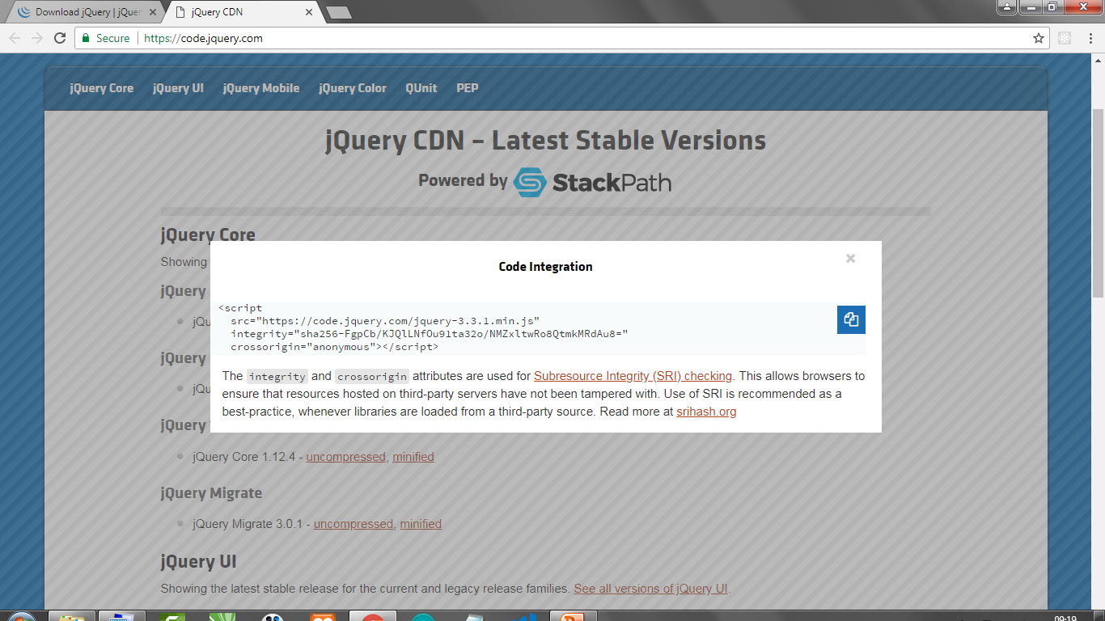
Setup
#1 Online
Insert CDN link (Works Online)
Copy the code from code.jquery.com
Insert it on HTML <head> first!

Slide 4
Setup
#2 Offline
Download from jquery.com (Works Offline)
Save its file on your project directory (better
on js folder), then link it to your HTML file.
<head>
<script
src="js/jquery-3.3.1.min.js">
</script>
</head>

Slide 5
1st jQuery Code
<head>
<script src="js/jquery-3.3.1.min.js">
</script>
</head>
<body>
<h1> Belajar jQuery </h1>
<script>
$(document).ready(function(){
$('h1').hide();
// $('h1').show();
// $('*').hide();
});
</script>
</body>

Slide 6
Selectors
<body>
<h1 class="iniclass">Halo jQuery</h1>
<h1 id="iniid">jQuery Itu Asik</h1>
<p>Yuk kuasai <span>jQuery</span>!</p>
<script>
$(document).ready(function(){
$('.iniclass').css('color','pink');
$('#iniid').css('color','blue');
$('p span').css('color','red');
});
</script>
</body>

Slide 7
Selectors
<body>
<h1 class="iniclass">Halo</h1>
<script>
$(document).ready(function(){
$('.iniclass').css({
color:'pink',
background:'black',
fontFamily:'Impact'
});
});
</script>
</body>

Slide 8
<body>
<ul class="daftar">
<li>Andi</li>
<li>Budi</li>
<li>Caca</li>
<li>Dedi</li>
</ul>
<script>
$(document).ready(function(){
$('.daftar').css('background-color','yellow');
$('.daftar li:first').css('color','red');
$('.daftar li:last').css('color','blue');
//$('.daftar li:even').css('color','red');
//$('.daftar li:odd').css('color','blue');
});
</script>
</body>
Nested
Selectors

Slide 9
Attribute Selectors
<body>
<p><input type="text" value="Ketik di sini!">
<p><input type="submit" value="Tombol 1">
<p><input type="button" value="Tombol 2">
<p><a href="http://google.com">Link 1</a>
<p><a href="http://yahoo.com">Link 2</a>
<script>
$(document).ready(function(){
// $(':text').hide();
// $(':submit').hide();
// $(':button').hide();
$('[href]').css('color','pink');
$('a[href="http://yahoo.com"]').css('color','red');
});
</script>
</body>

Slide 10
Event
Click Alert
<body>
<button id="tombol1">Tombol 1</button>
<button id="tombol2">Tombol 2</button>
<script>
$(document).ready(function(){
$('#tombol1').click(function(){
alert('Tombol 1 ditekan!');
});
$('#tombol2').on('click', function(){
alert('Tombol 2 ditekan!');
});
});
</script>
</body>

Slide 11
Event
Click Show & Hide
<body>
<button id="tombol1">Tombol 1</button>
<button id="tombol2">Tombol 2</button>
<p class="note">Halo Dunia!</p>
<script>
$(document).ready(function(){
$('#tombol1').click(function(){
$('.note').hide();
});
$('#tombol2').on('click', function(){
$('.note').show();
});
});
</script>
</body>

Slide 12
Event
Click Toggle
<body>
<button id="tombol1">Tombol 1</button>
<p class="note">Halo Dunia!</p>
<script>
$(document).ready(function(){
$('#tombol1').click(function(){
$('.note').toggle();
});
});
</script>
</body>

Slide 13
Event
Click Toggle with Delay
<body>
<button id="tombol1">Tombol 1</button>
<p class="note">Halo Dunia!</p>
<script>
$(document).ready(function(){
$('#tombol1').click(function(){
$('.note').toggle(1000, function(){
alert('Tombol ditekan!');
});
});
});
</script>
</body>

Slide 14
Event
Double-Click
<body>
<button id="tombol1">Tombol 1</button>
<p class="note">Halo Dunia!</p>
<script>
$(document).ready(function(){
$('#tombol1').dblclick(function(){
$('.note').toggle();
});
});
</script>
</body>

Slide 15
Event
Hover
<body>
<button id="tombol1">Tombol 1</button>
<p class="note">Halo Dunia!</p>
<script>
$(document).ready(function(){
$('#tombol1').hover(function(){
$('.note').toggle();
});
});
</script>
</body>

Slide 16
Event
Mouse Move
<body>
<button id="tombol1">Tombol 1</button>
<p class="note">Halo Dunia!</p>
<script>
$(document).ready(function(){
$('#tombol1').on('mousemove', function(){
$('.note').toggle();
});
});
</script>
</body>

Slide 17
Event
Mouse Up & Down
<body>
<button id="tombol1">Tombol 1</button>
<p class="note">Halo Dunia!</p>
<script>
$(document).ready(function(){
$('#tombol1').on('mousedown', function(){
$('.note').toggle();
});
$('#tombol1').on('mouseup', function(){
$('.note').toggle();
});
});
</script>
</body>

Slide 18
Getting Information from Browser
<body>
<button id="tombol1">Tombol 1</button>
<script>
$(document).ready(function(){
$('#tombol1').click(function(x){
console.log(x);
// alert(x.currentTarget.id);
// alert(x.currentTarget.innerHTML);
// alert(x.currentTarget.outerHTML);
});
});
</script>
</body>

Slide 19
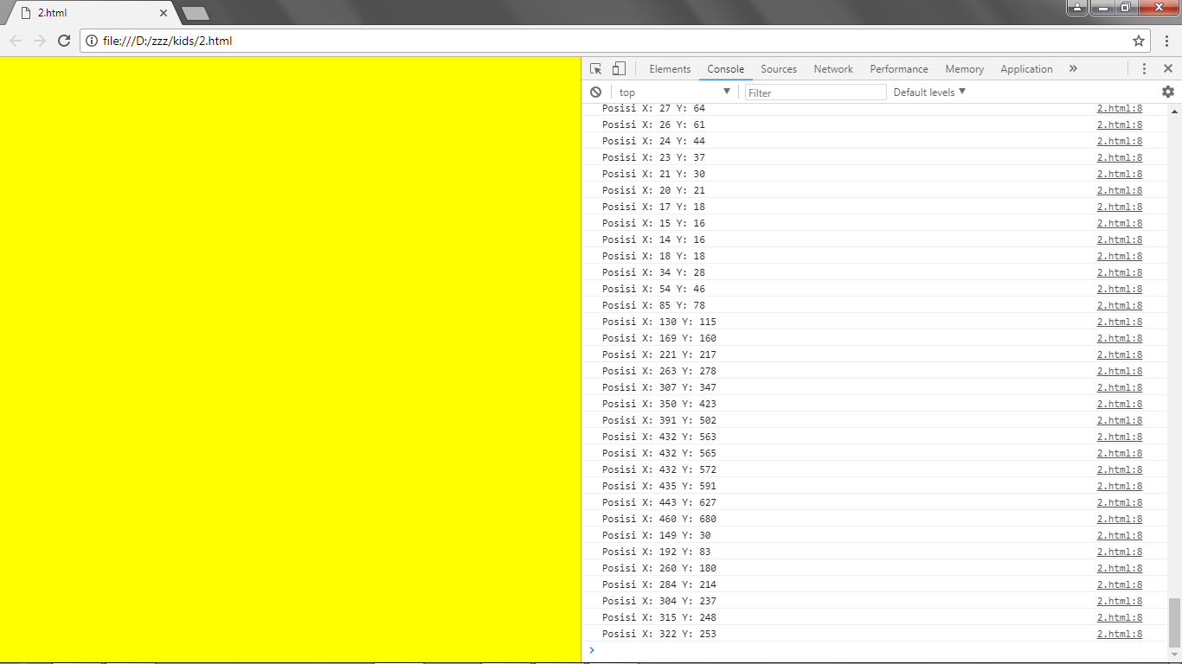
Getting Information: Cursor Position
<body style="background-color:yellow">
<script>
$(document).ready(function(){
$(document).on('mousemove', function(pos){
console.log('X: '+pos.clientX+' Y: '+pos.clientY);
});
});
</script>
</body>

Slide 20
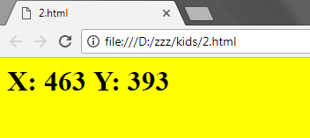
Getting Cursor Position & Embed on Browser
<body style="background-color:yellow">
<h1 id="a"></h1>
<script>
$(document).ready(function(){
$(document).on('mousemove', function(z){
$('#a').html('X: '+z.clientX+' Y: '+z.clientY);
});
});
</script>
</body>

Slide 21
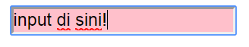
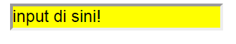
Event
Input Form
<body>
<input type="text">
<script>
$(document).ready(function(){
$('input').focus(function(){
$(this).css('background','pink');
});
$('input').blur(function(){
$(this).css('background','yellow');
});
});
</script>
</body>

Slide 22
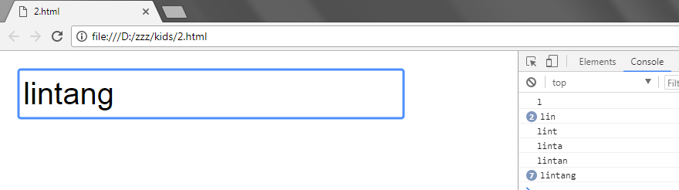
Event
Get User Input
<body>
<input type="text">
<script>
$(document).ready(function(){
$('input').keyup(function(x){
console.log(x.target.value);
});
//try too: .keydown
});
</script>
</body>

Slide 23
Event
Select Form
<body>
<select id="sex">
<option value="Aku_Pria">Laki-laki
</option>
<option value="Aku_Wanita">Perempuan
</option>
</select>
<script>
$(document).ready(function(){
$('select#sex').change(function(pilih){
alert(pilih.target.value);
});
});
</script>
</body>

Slide 24
Event
Full Form
<body>
<form id="formulir">
<p><input type="text" id="nama">
<p><input type="number" id="usia">
<p><select id="sex">
<option value="pria">Laki-laki</option>
<option value="wanita">Perempuan</option>
</select>
<p><input type="submit">
</form>
<script>
$('#formulir').submit(function(x){
x.preventDefault();
console.log('Formulir terisi!');
});
</script>
</body>

Slide 25
Event
Get User Form Input
<script>
$('#formulir').submit(function(x){
x.preventDefault();
var nama = $('input#nama').val();
var usia = $('input#usia').val();
var sex = $('select#sex').val();
console.log(nama+usia+sex);
});
</script>

Slide 26
Simplifying JavaScript

